Slide 1
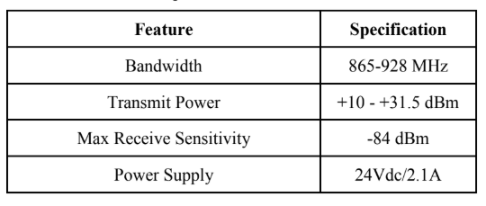
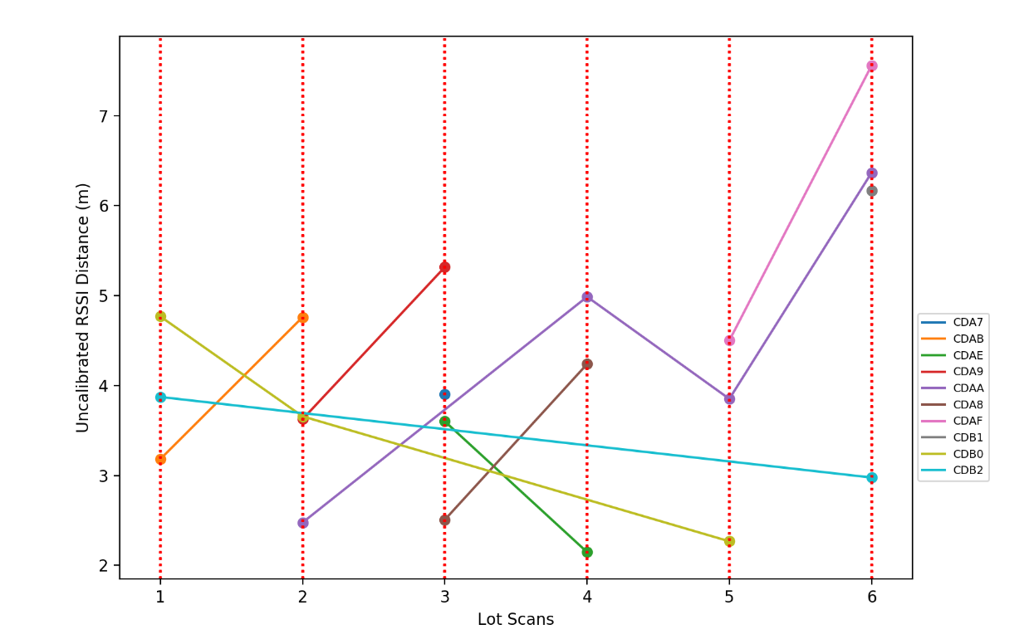
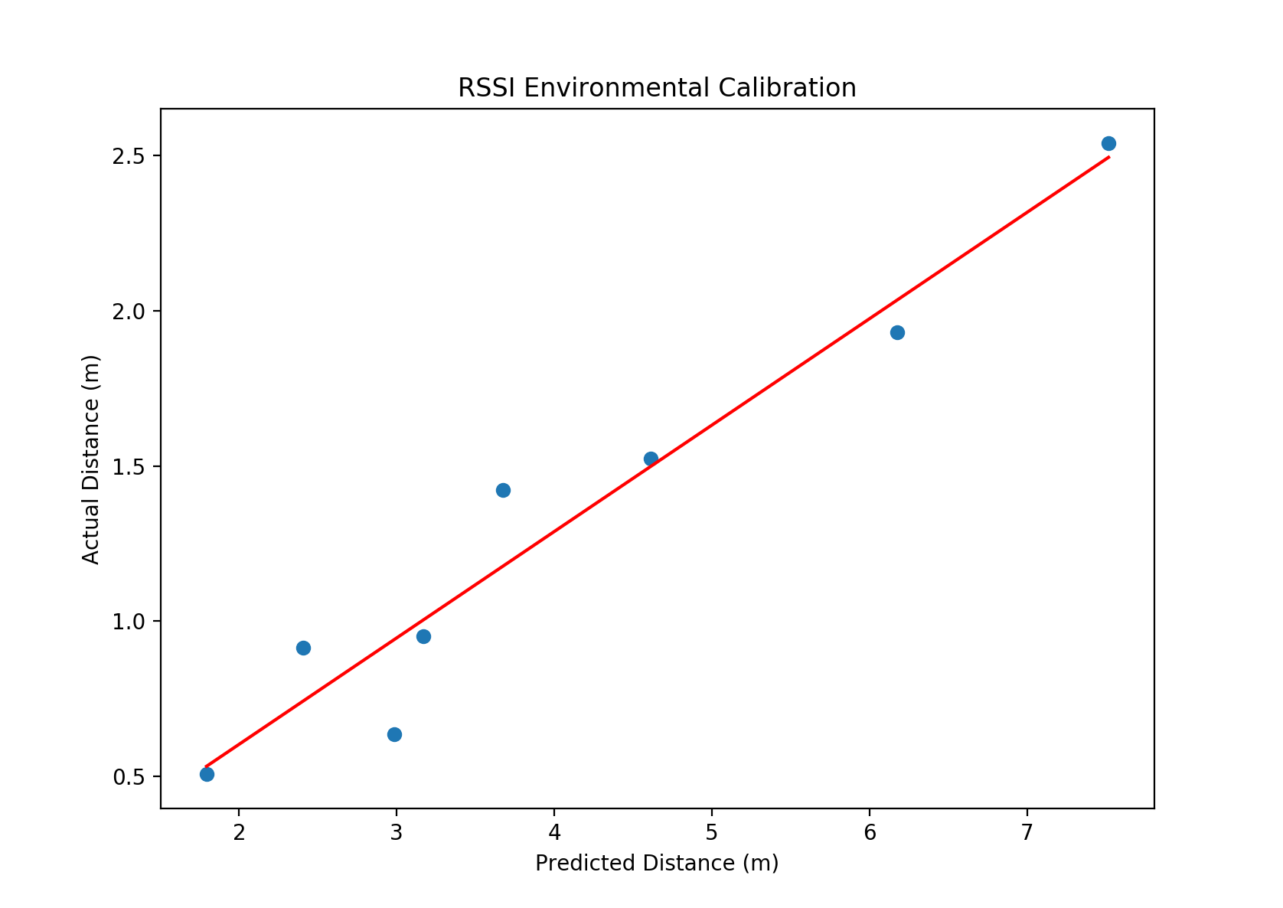
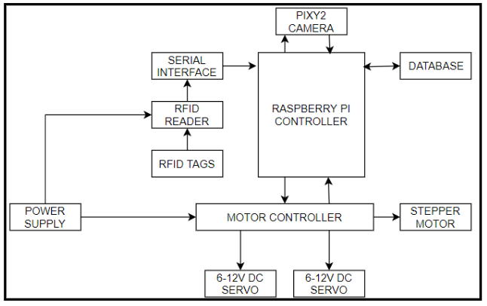
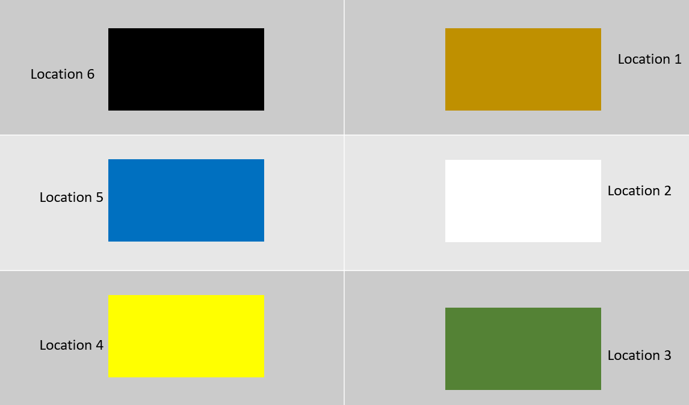
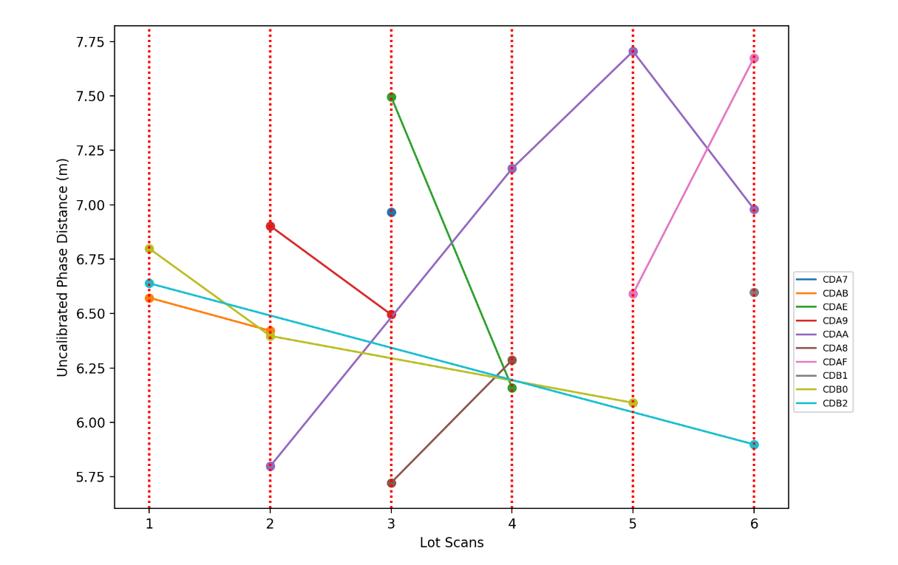
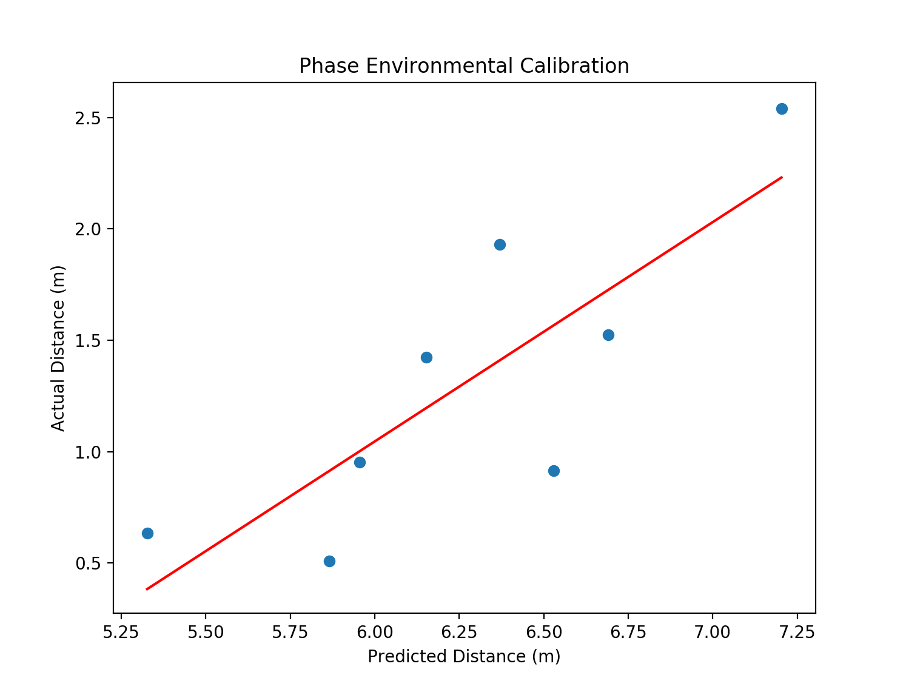
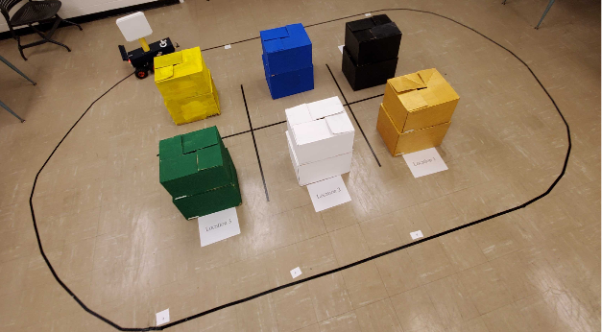
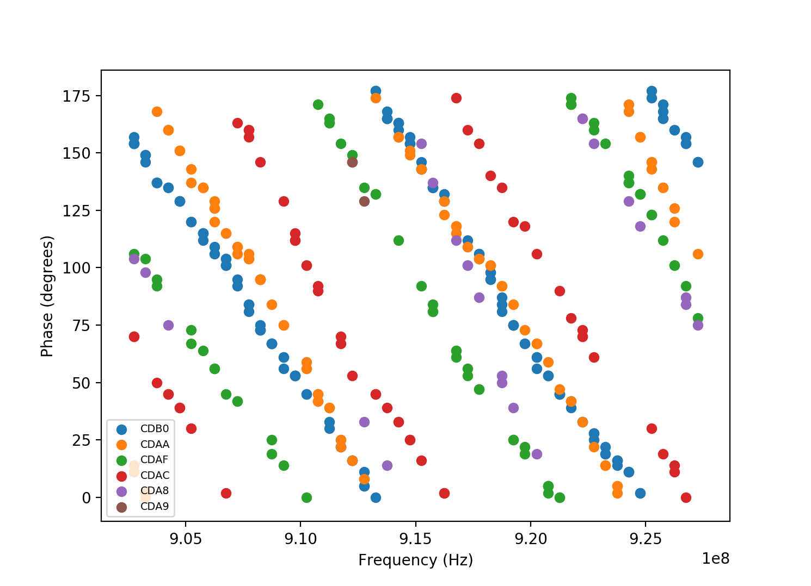
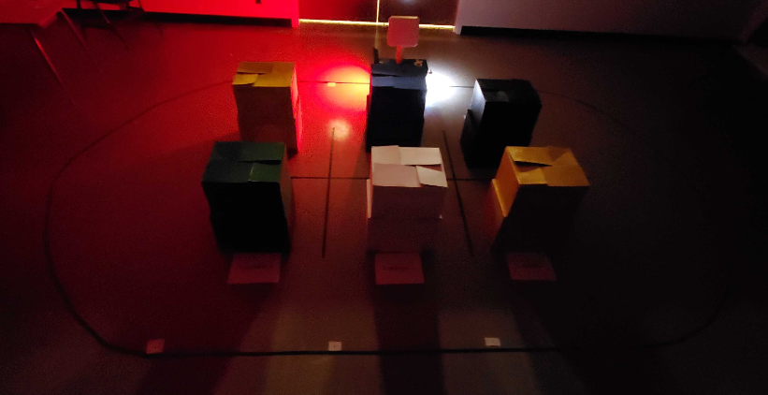
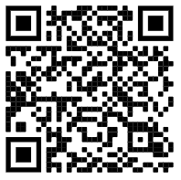
Autonomous Inventory Tracking Using Robotic RFID Scanning
Calvin Burran, Shelby Conway, Brandon Goddard, Caleb Martinez, Yu Jun Qin and Dustin Snyder
Georgia Institute of Technology School of Electrical and Computer Engineering
Objective
Specifications
Results
The objective of AITURRS is to create a self-operating robot capable of maneuvering around an environment using the Pixy 2 vision sensor. Using a mounted RFID scanner, the robot reads RF tags associated with individual assets, and determines the location and ID of the asset with a microcontroller. It transmits that data wirelessly to an online database holding the location information of all items in inventory.
Testing Set-Up
Prototype Materials and Cost
Part | Cost
Raspberry Pi 4 | $118.90
Pixy Camera | $60.00
Motor Driver | $25.00
915 MHz Circular Polarity RFID Panel Antenna | $500.00
Chassis | $180.00
NiCD RC Batteries | $40.00
Total | $923.90
Night Tracking Capabilities
Contact
Visit our website to learn more about our project:
https://qrgo.page.link/y3Asx

