Slide 1
Autonomous Inventory Tracking Using Robotic RFID Scanner
By: Nic Burran, Shelby Conway, Brandon Goddard, Caleb Martinez, Jun Qin, and Dustin Snyder

Slide 2
Introduction
Mobile robotic system with RFID scanner
Capable of self-navigating a warehouse and updating inventory database
Help avoid shrink and excess manual labor
Notes:
Dustin

Slide 3
Project Goals
General
Robot that can operate autonomously based on landmarks
Target market value is $3,299.00
Robot Capabilities
Line detection to control movement
Transmit data to a remote server
Arm with vertical movement to accurately scan shelves of different heights
RFID Scanner
Detect tags to indicate when inventory is located
Scan tags to procure pertinent information about the detected inventory
Record data and send information about the inventory to Raspberry Pi
Notes:
Dustin

Slide 4
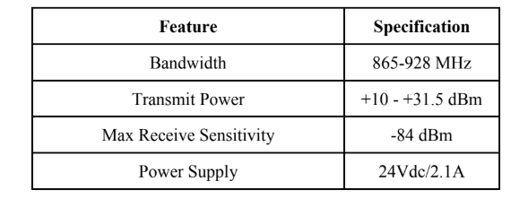
RF Specifications
Notes:
Nic

Slide 5
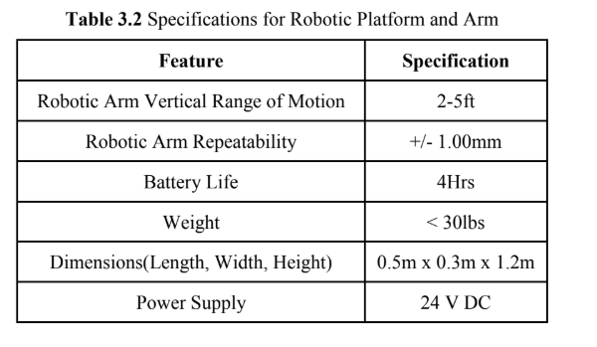
Robotic Platform and Arm Specifications
Notes:
Nic

Slide 6
Design Approach
Robot will consist of RFID reader, microcontroller, motor control system, and vision system
A motor controller to power the Raspberry Pi as well as the motors
Two DC motors for forward locomotion
Stepper motor for vertical motion of the RFID reader
Pixy 2 camera line tracking program for directing the motion of the robot
Notes:
Shelby

Slide 7
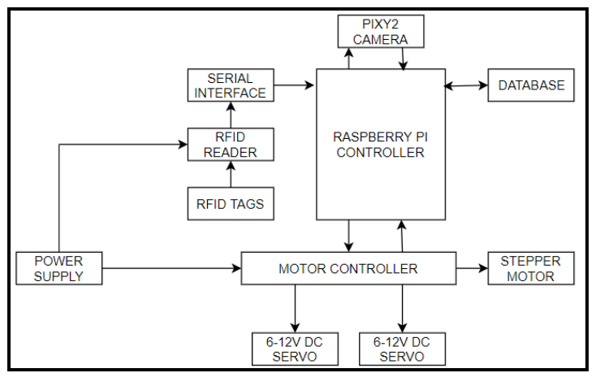
Block Diagram of the RFID Robot System
Notes:
Caleb

Slide 8
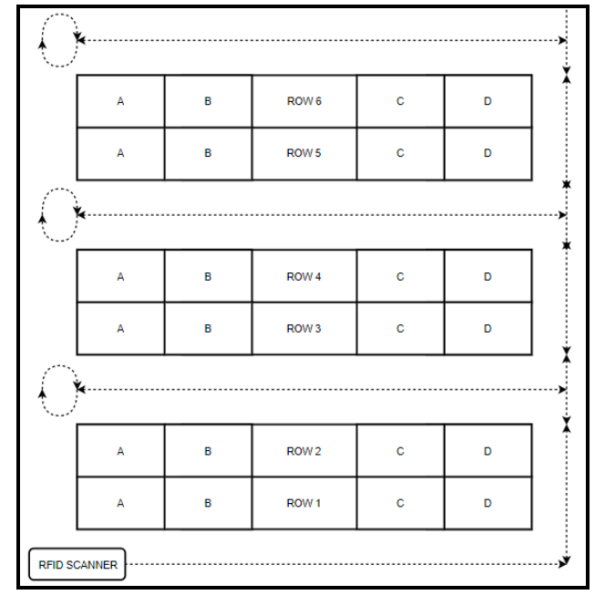
Robot Movement Using Pixy 2 Line Tracking
Notes:
Caleb

Slide 9
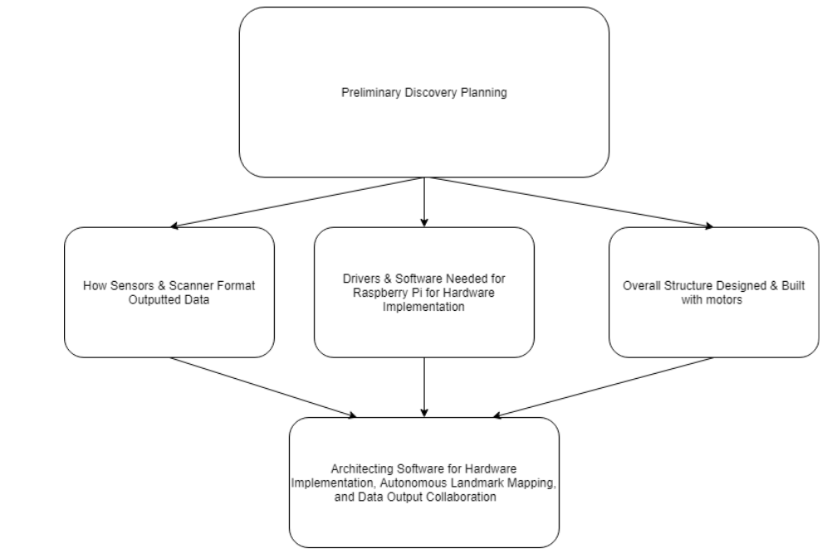
Solution to Finishing Critical Path
Notes:
Brandon (talk about software dev and database)

Slide 10
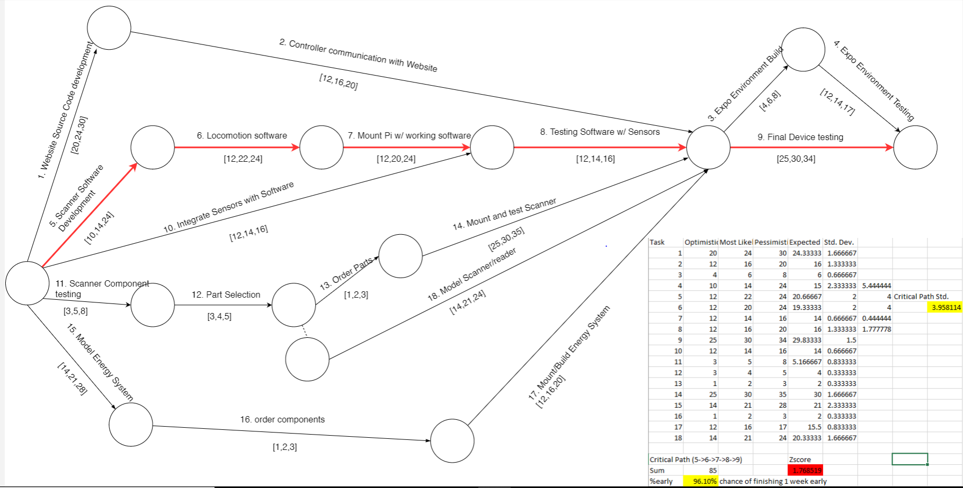
Schedule
Notes:
Dustin

Slide 11
TBD
Weight
Type of DC motors to support motion of chassis
Power Requirements Motor power draw + RFID + RPi
RFID
Tilt/Pan vs Vertical Motion
Link Budget and Scanning Algorithm
Notes:
Jun

Slide 12
Current Status
General
Jira setup for internal task breakdown and sprint management
Bitbucket setup for code collaboration
Gantt chart for timing of deliverables
Fall semester roles assigned
Raspberry Pi
Database & HTTP server deployed
Servo motor moved off of pin call
RF Technology
Scanner secured from Dr. Durgin
RF Lab access granted for testing scanner capabilities
Notes:
Jun

