Slide 1
Sixplus: infantry iff system final presentation
Vijay Krishnan, Kevin Waddles, Vishal Devidas, Leo Han, Rishabh Patel

Slide 2
Objective
* To design a portable, low-power, and lightweight IFF (identification friend or foe) system that will allow infantry soldiers to determine if a target is an ally or not through the fog of war.

Slide 3
Design: Overview
9 V battery power source with a virtual ground at 4 V to create +5 V and -4 V power rails. Required to power TL071 op-amps.
Multi-feedback, infinite-gain band pass filter at 100 kHz and quality factor of 20.
Preceding voltage divider and buffer to counteract high gain from band pass filter.
Half-wave rectifier to ensure positive polarity.
Raspberry Pi zero w as the Bluetooth module and the Processing Unit.
An Initiator to initiate the inquiry
An Indicator united to give visual feed back
A battery system to supply power to the entire system

Slide 4
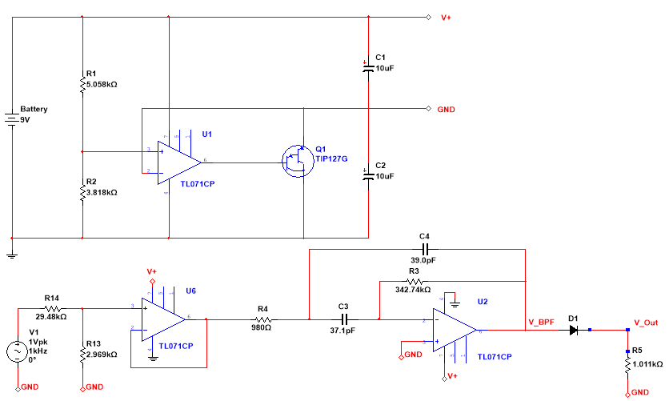
Circuit Schematic: Analog Design

Slide 5
Circuit Schematic: Bluetooth Module

Slide 6
Analog Design: BAND PASS FILTER Equations
$$f_{0}=\frac{1}{2π\sqrt{R_{1}R_{2}C_{1}C_{2}}}=100 kHz$$
$$Q=\frac{1}{2}\sqrt{\frac{R_{2}}{R_{1}}}=20$$
$$A_{v}=\frac{R_{2}}{{−2R}_{1}}$$

Slide 7
Analog to Digital Converter (ADC)
Output of analog filter cascaded with an ADC to integrate 2.4 GHz and 24 GHz modules.
FMCW radar Tx output specifications:
Chirp Time = 3000 μs
Chirps per Frame = 42
Total frame interval = 150 ms
Sampling rate of 1 kHz (to meet Nyquist rate) at filter output to calculate average voltage over 150 points.
$\frac{1}{1000 kHz}∗150=0.15 s=150 ms$
Output average compared with threshold voltage to produce 1-bit digital output.

Slide 8
Final Design
Bluetooth Module
FMCW Radar
Initiator & Indicator Units
ADC Module
MP-IG BP Filter

Slide 9
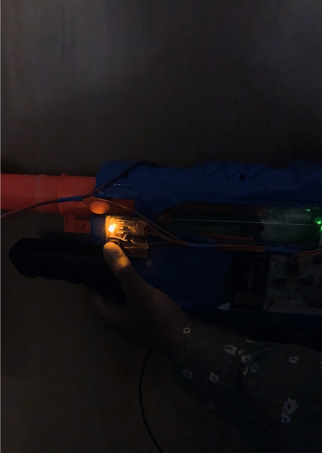
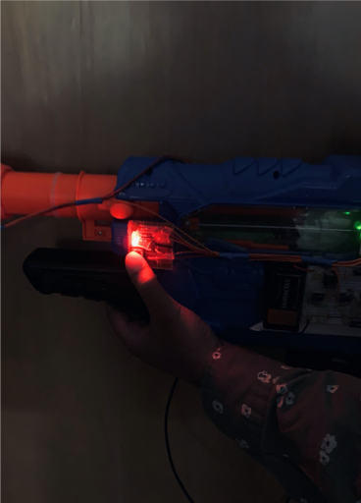
The Indicator
In Range/Line of Fire
In Range/Not in Line of Fire
Not in Range

Slide 10
Measurements: Analog Filter Specifications
$$f_{0}=106.355 kHz$$
$$Q=9.351$$
$$A_{v}=174.864∗0.0915=16.000$$
Threshold voltage $V_{t}=0.060 V$
Operational range of FMCW and backscatter array = 10 m

Slide 11
Specifications: Bluetooth module
Operates at 5V and 2.5A input
Bluetooth Range: 30 meters
16 bytes Encrypted signal
Delay time: 50 ms

Slide 12
Encryption Specifications
Implemented Encryption: 8-byte variable encryption applied over two 4-byte sequences. All devices contain dynamic decryption libraries utilizing the same encryption algorithm applied to simultaneously changing seed values.
Signal Type: Bluetooth Beacon (16 byte)
Encryption Resolution: 8 bytes for authentication

Slide 13
Drawbacks to analog filtering
Bulky discrete components
High variability due to components and low power rail voltage
Additional battery as power source
Intermediate stage between FMCW radar and ADC
Limited order for band pass filter
Rectification of signal to correct negative polarity of AC signal

Slide 14
Drawbacks to Bluetooth Module
With growing number of devices the delay increases linearly
Range is limited (Could be improved using new Bluetooth technology)
Could be easily intercepted by other devices operating at the same frequency (denial of service attacks)

