Slide 1
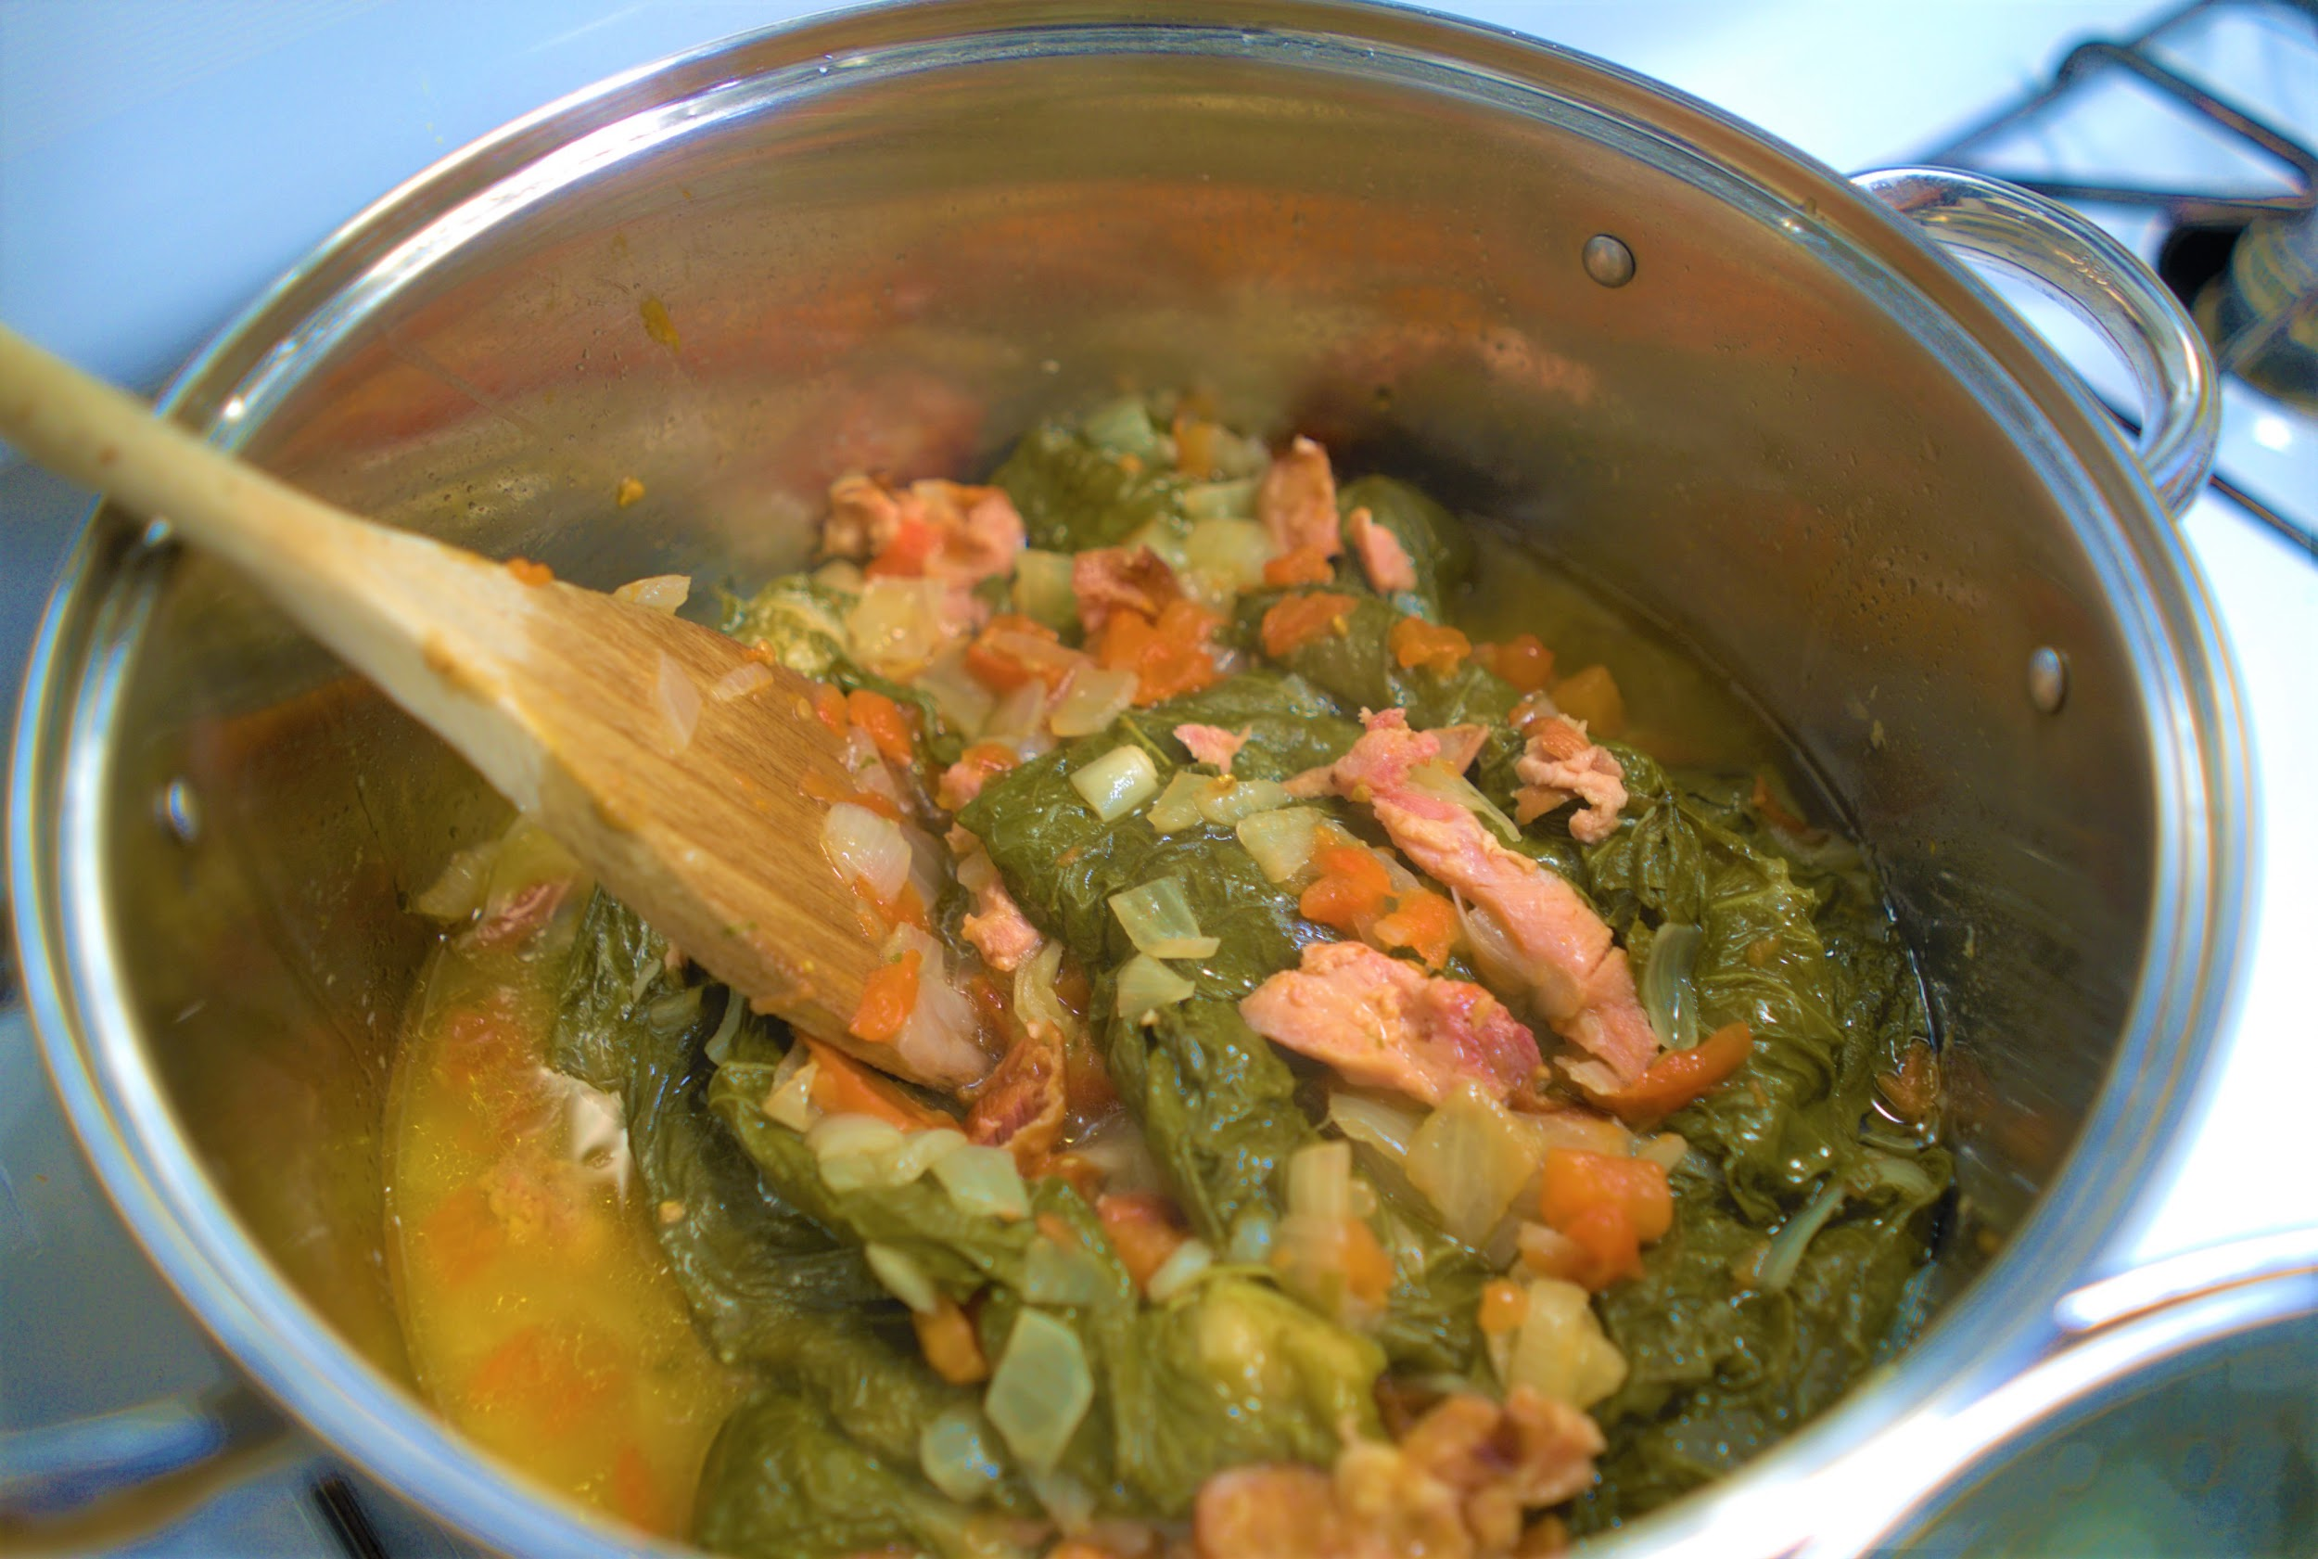
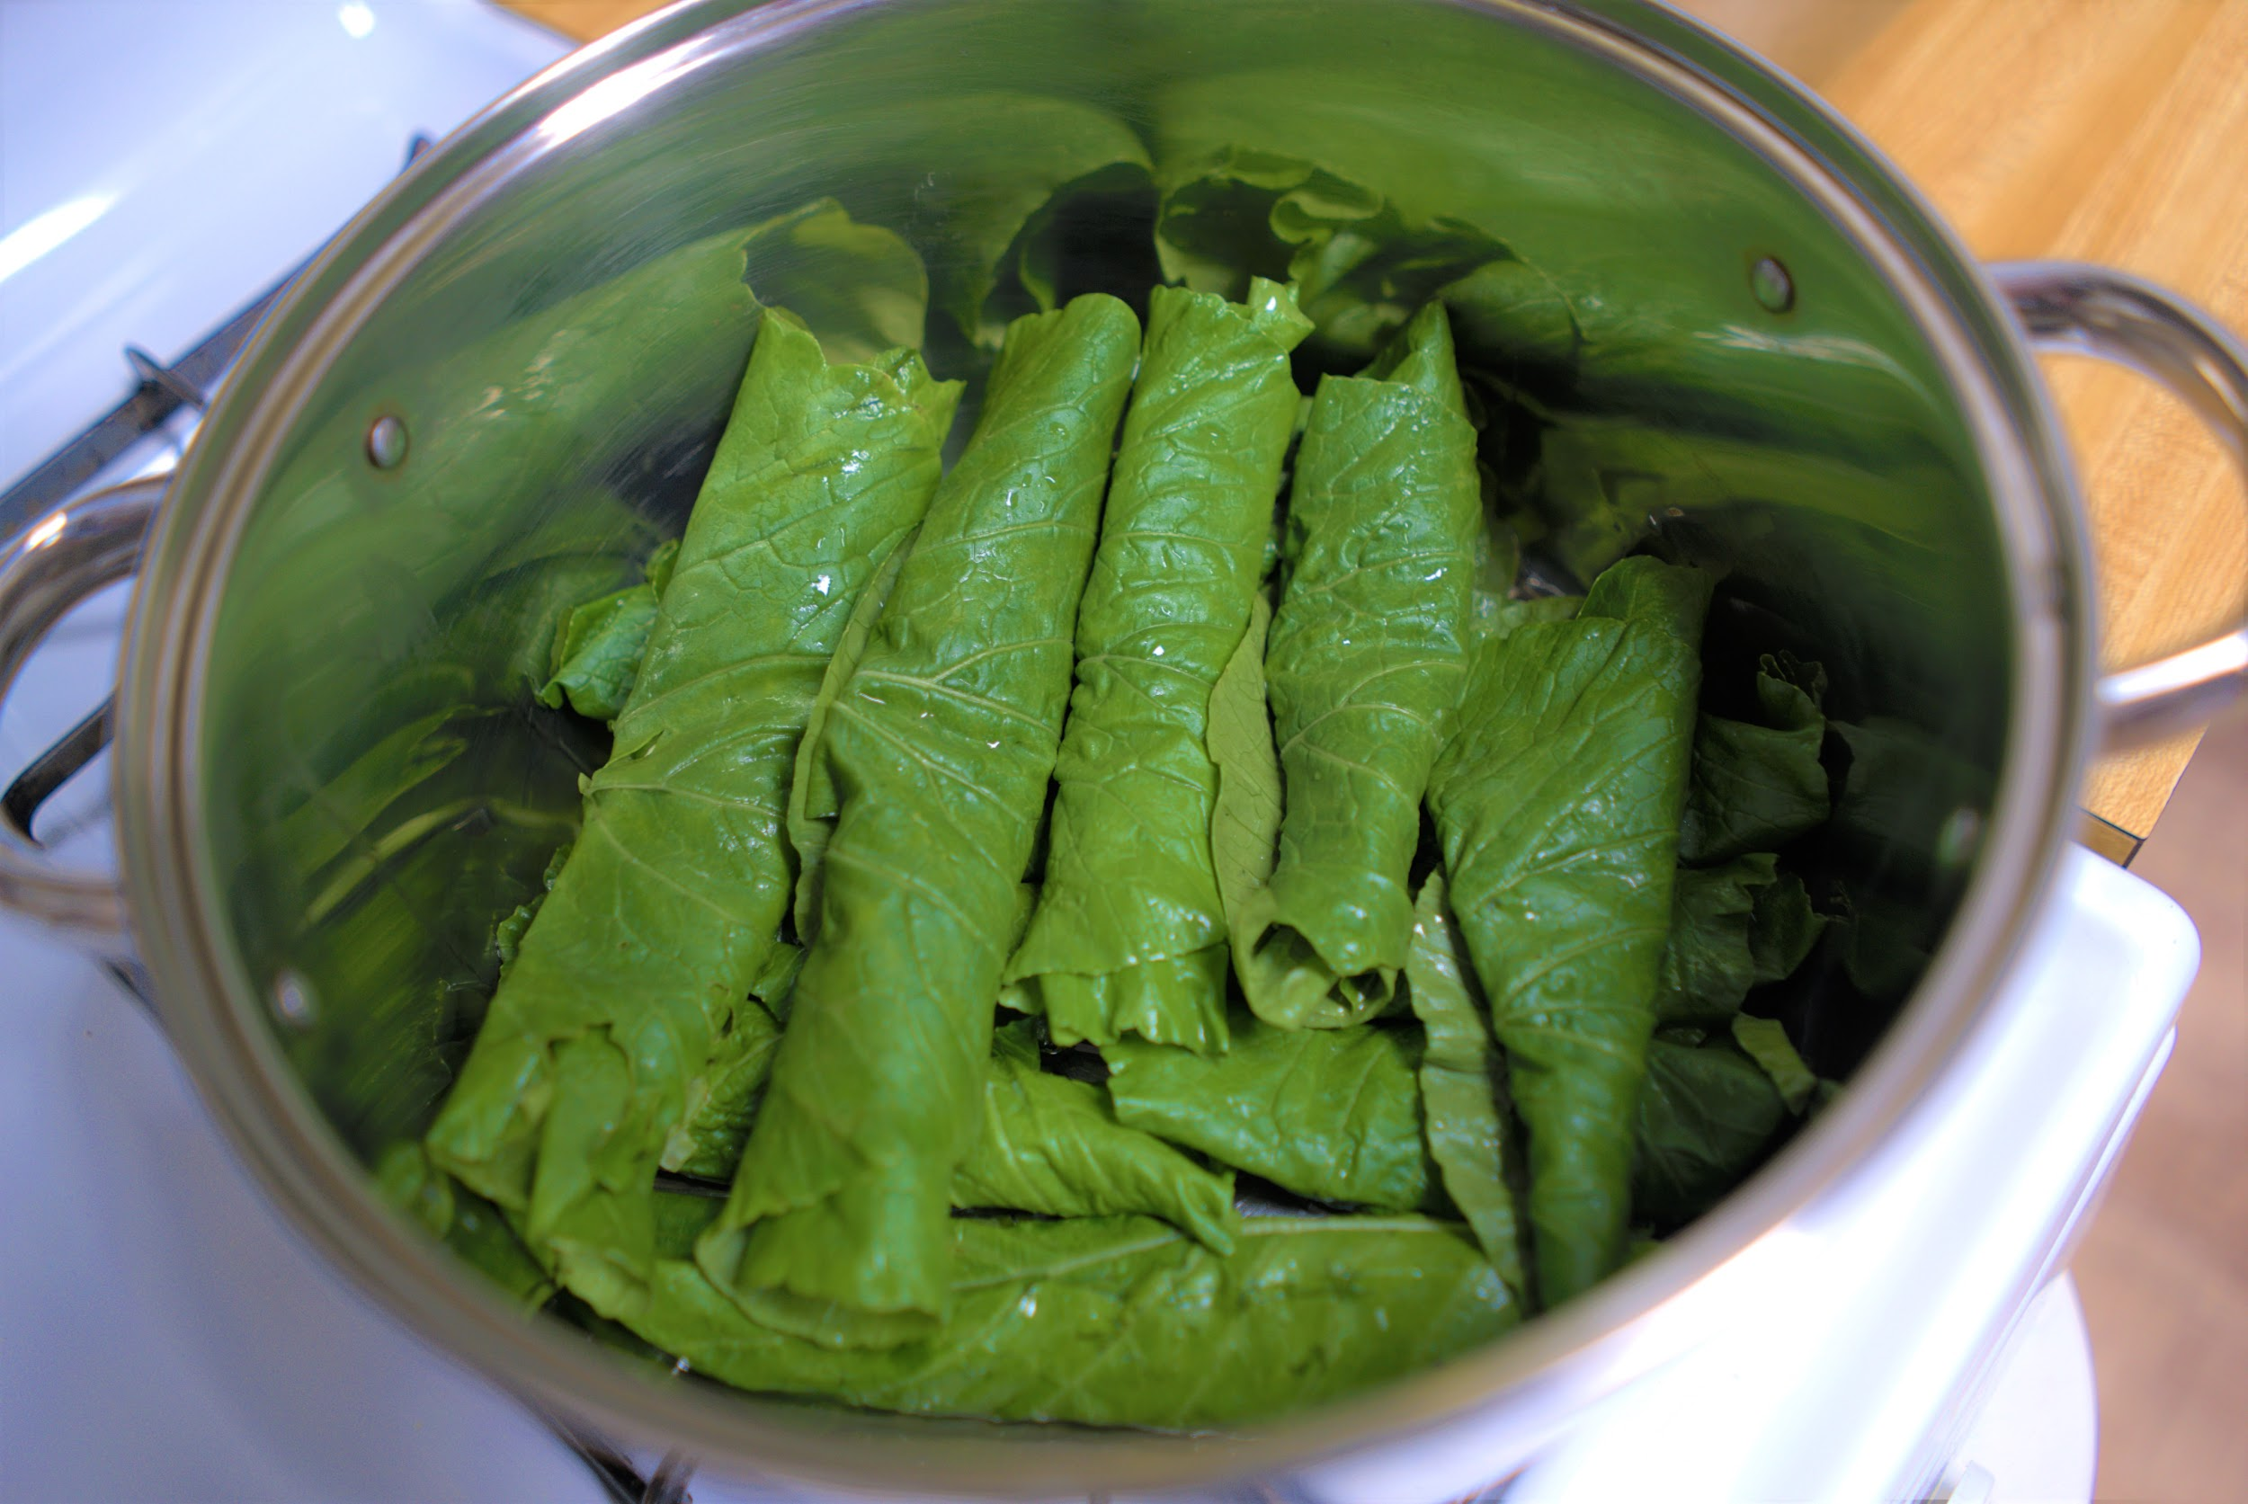
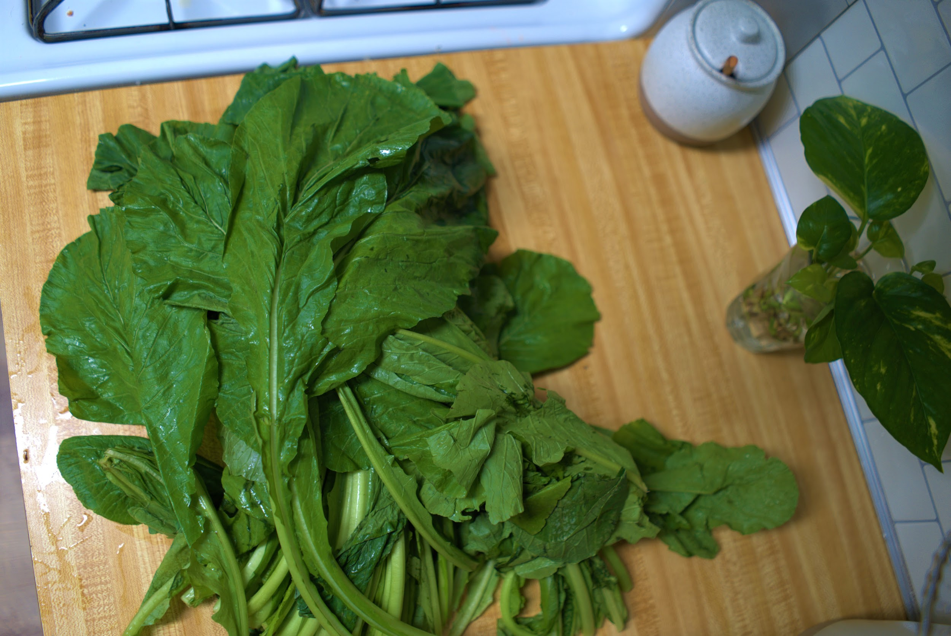
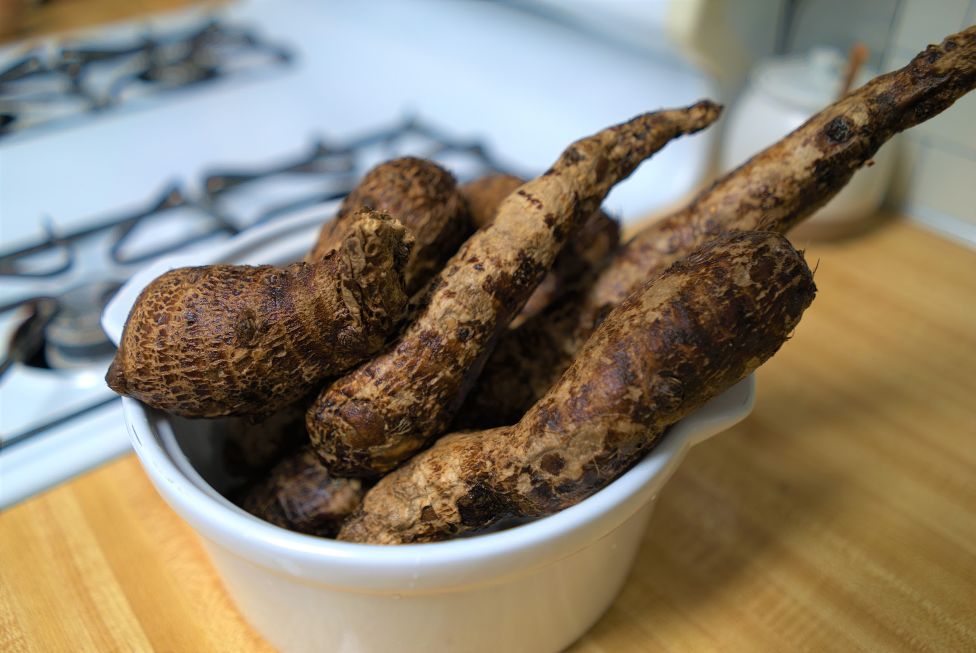
Ekwang: Wrapping leaves to feed needy families
Curtis Cooper, Jeongmin Huh, Dawit Jekamo, Ephrem Lombebo, Zhiming Xue, Alha Kane
Advisors: Dr. Elliot Moore, Dr. Amit Jariwala, Dr. Isaac Zama
Problem
In Cameroon, other parts of Africa and the diaspora, Ekwang is a time consuming food to wrap. 30 to 40 minutes are typically spent just for wrapping enough leaves for a family dinner. There are devices in the current market to wrap other foods, but these devices are not meant for leaves or are not the proper size to handle turnip leaves.
Background Information
Ekwang is a staple food eaten primarily in Cameroon, a country in the middle of a civil war and with no stable electricity (Bone, 2019).
Consists of a root that is mashed and wrapped in a turnip-like leaf
Takes 15 - 20 seconds per wrap by hand
Eaten at least once a week
Goals
Develop a low cost manual and electrical wrapping device that can quickly and consistently wrap the mash in turnip greens.
Specifications and Results
¹D&F Liquidators, 2019
Methodology
Researched the current food-wrapping products and processes available in the market
Set a brainstorming period to allow team members to come up with original design ideas
Selected from the proposed designs, the design which had a potential for both electric and manual modes of operation and developed a proof of concept prototype to test the feasibility of the wrapping mechanism
Selected and tested for feasibility a second design idea, following unsatisfactory test results of the first design choice
Built an initial prototype of the second design idea after a successful feasibility test
Before arriving at this presented prototype, 3 design iterations were performed (after the initial prototype) with major design changes on both the mechanical and electrical versions
Discussion
Market strategy: Simplifying the preparation processes to meet a high consumer demand.
Future Work
Motor and Sensor could be better coordinated with each other.
Design could be streamlined for construction with less number of components.
Wrapping mechanism could be fine-tuned with more nuanced precision in design.
References
Bone, M. (2019, August 23). Cameroon's civil war will continue. Retrieved November 11, 2019, from https://mg.co.za/article/2019-08-23-00-cameroons-civil-war-will-continue.
D&F Liquidators (2019, April 6). The Effect of Temperature on Electrical Enclosures & How to Keep Them Cool. Retrieved September 9, 2019, from https://www.dfliq.net/blog/effect-temperature-electrical-enclosures-keep-cool/.
Nigeria: Agricultural Producation: Cocoyam: Economic Indicators (2019, Sep 10). National Bureau of Statistics of the Federal Republic of Nigeria. Retrieved Jan 1970, from https://www.ceicdata.com/en/nigeria/agricultural-production
https://www.amazon.com/Stuffed-cabbage-Rolling-Machine-Universal/dp/B00WSNO1UW
 | Dolmer rolling machine | Manual Modified | Electrical Modified
Turnip Leaf | No | Yes | Yes
Product Size (Inches) | 14x3.9x2.9 | 9x5.4x3 | 17x8x8.3
Target groups | General | West Africa Families
Description | Desired Values | Measured Values
Weight of wrap (average) | 18 g +/- 2g | 16.5g
Total weight of appliance | <2 lbs | 11 lbs
Energy efficiency (power usage) | <25W | 22.85W max
Speed of wrapping leaves (<20s per wrap) | ≤10 s | 8.48 s
Repeatable & predictable motions | 200 wraps with no jams | 25 wraps with no jam
Ease of assembly | <5 pieces to assemble | 24 pieces
Compactable into | Fits into 12” x 8“' x 4” box | 17” x 8” x 8.3”
Prevents against overheating | Circuit <50°C ¹ | 20.5°C
Wrap diameter | ≤ 2 cm | 2.22cm
Notes:
https://www.ceicdata.com/en/nigeria/agricultural-production/agricultural-production-cocoyam.
https://www.ceicdata.com/en/nigeria/agricultural-production/agricultural-production-cocoyam.

