Slide 1
Proposal Presentation:
First Response Fire Brigade
Autonomous Fire Fighting Robot Smart Home System
Natalie Rakoski
Zack Elliott
Thomas Wyatt
Christopher Wang
Ricky Marscel
Deniz Bozkurt
Adrian Dole
Ryan Avery

Slide 2
Motivation
On average, 7 people per day die in house fires in the United States.
Building fires are responsible for > $10 billion of property damage annually.
On average, it takes a minimum of 5-10 minutes for first responders to arrive after fire is detected by an automated fire detection system.
This project aims to reduce loss of life and reduce property damage by shortening the time between when a fire starts and when it is responded to.
Notes:
Natalie

Slide 3
Qualitative goals
Develop a robot that can respond to fires in a home or office
Self-localize and navigate to specific, known rooms in a single story of a residential home
Search a room and locate fires using an IR camera
Extinguish or suppress common household fires
Aim and actuate a fire extinguisher
Control spray while extinguisher is activated
Develop a system of smart fire detectors that can dispatch the robot
Detect fires at an early stage
Relay data and warnings to the robot
Relay data and warning to an interface for user monitoring
Perform as a fire alarm
Emit a loud, distinct noise upon detection of a fire
Notes:
Thomas

Slide 4
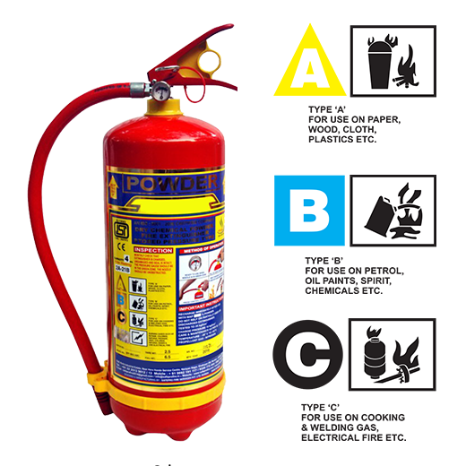
Quantitative specifications
Robot
Start responding to fire within 5 seconds of detection
Handle navigation at robot’s full speed of 2 ft/s
Limited to 1 floor, open plan. Robot cannot transcend steps or open doors
Locate and accurately spray fires from up to 10 feet away
Put out incipient fires of type A, B, and C
A - wood, paper, cloth, etc.
B - gasoline, oil, etc.
C - electrical wiring
Max Payload: 20 Kg
Smoke detector
Detect smoke at a threshold of 550 PPM
Use MQTT to directly convey location of fire to Robot
Notes:
Zack
1 floor, open plan, known (previously generated) map/floorplan
Limits on effectiveness (we aren’t planning to extinguish a full-home blaze, just to stop or reduce small, incipient fires)

Slide 5
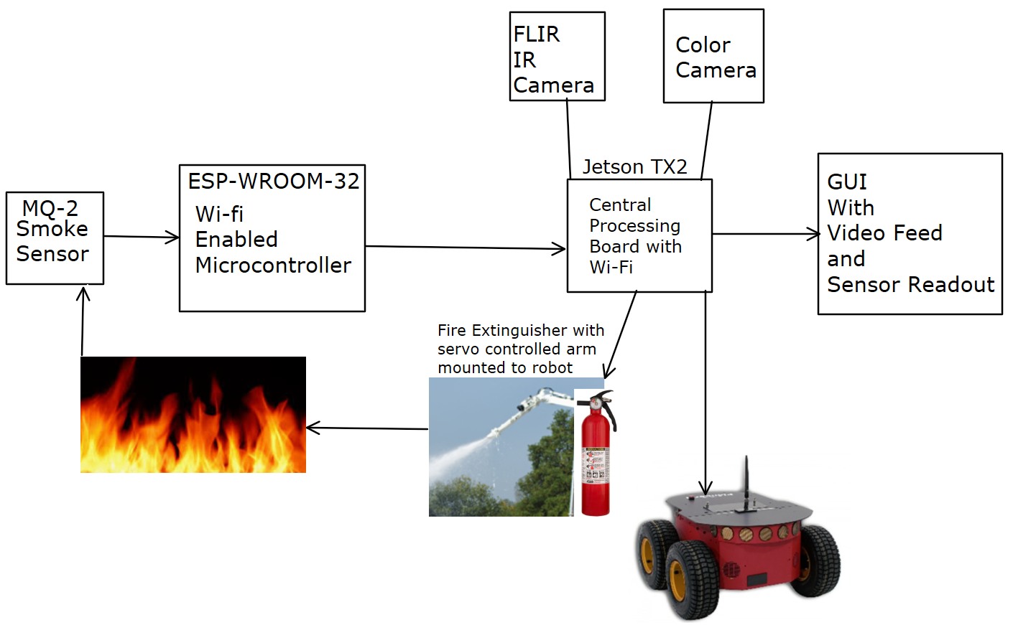
Design approach
Notes:
Zack

Slide 6
Software and Hardware selection
General robot control: Robot Operating System (ROS)
Provides intuitive framework for modular control software
Provides extensive libraries for sensor processing, navigation, and monitoring
Provides a built-in system for running parallel nodes and passing messages
Communication with smoke detectors: MQTT
Lightweight network messaging protocol with publisher/subscriber model
Using Mosquitto MQTT broker on the jetson to manage message passing
Using ros mqtt_bridge library to forward mqtt topics to ros topics

Slide 7
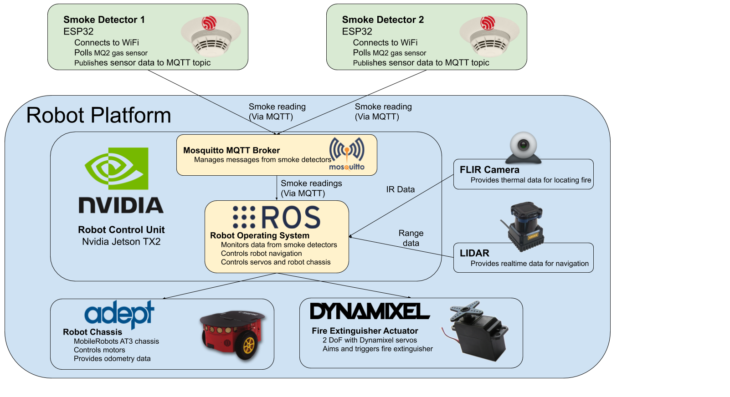
Block Diagram
Hardware unit
Software unit
Combined HW/SW
Notes:
Thomas

Slide 8
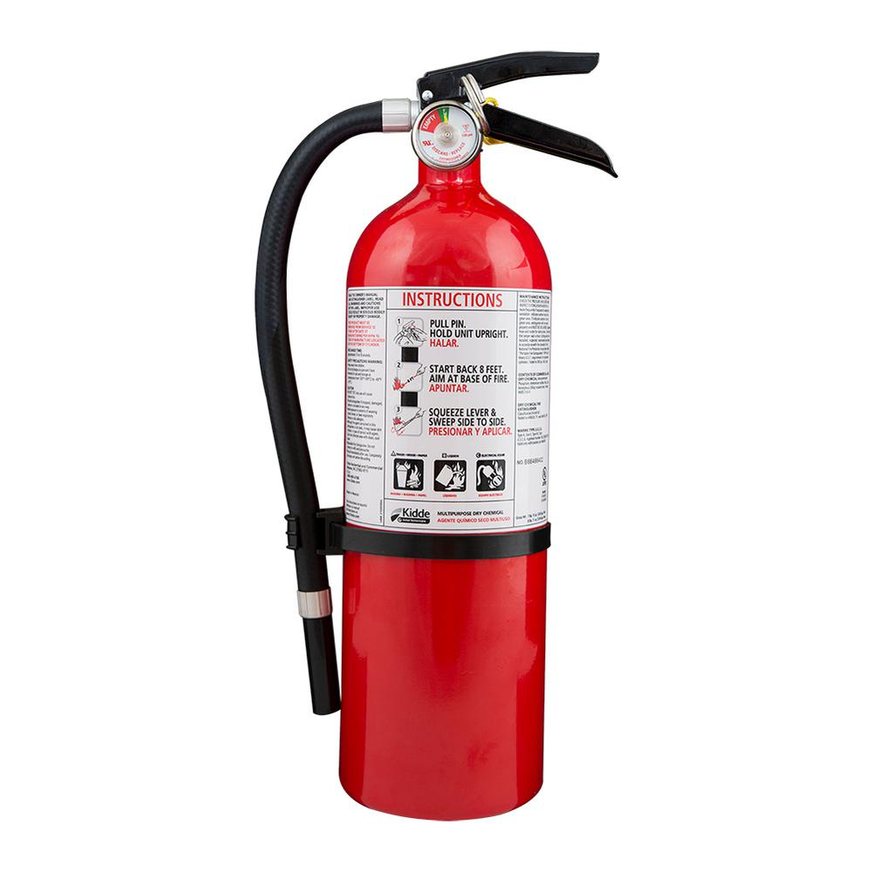
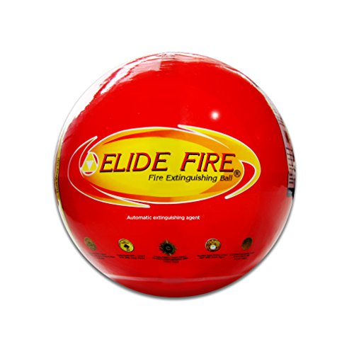
Ideation
Requirement | Solutions
Fire Extinguisher Type | Conventional |  |  | Ball
Activate Fire Extinguisher | Electricity | Push | Pull | Projectile | Roll
Notes:
Ryan
There are a few major design decisions on the mechanical side of things, the first of which is what type of fire extinguisher to use. During research, we found a lot of unconventional options out there, such as a temperature activated ball that can be thrown or rolled into a fire. However, we will likely be going with a more conventional extinguisher since it will be easier to aim and can be refilled and reused. One option for activating our extinguisher is using a purpose built electronic extinguisher. Another option will be using a linear actuator or solenoid to push or pull on the handle. One potential benefit of pulling would be the option to use pulleys to create mechanical advantage, if needed.

Slide 9
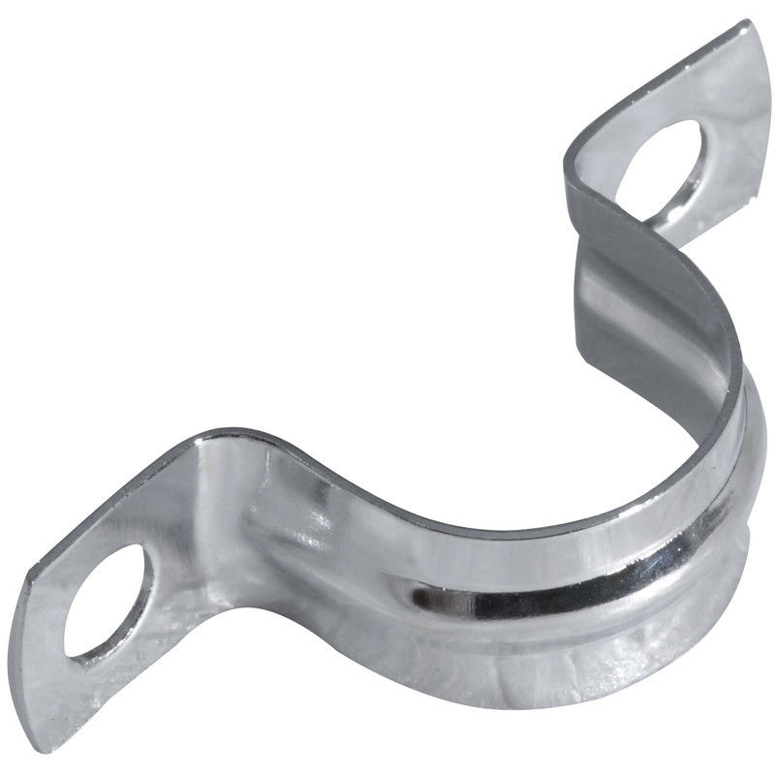
Ideation
Requirement | Solutions
Aim Fire Extinguisher | Rotate Portion of Hose | Rotate Entire Extinguisher
Mount Fire Extinguisher | Bracket | Enclosure
Notes:
Ryan
In order to aim, we will be rotating a portion of the hose rather than the entire extinguisher, as it requires less force from our servos. In order to mount the extinguisher, we will be using a bracket as it is cheaper, less heavy, and easier to replace the extinguisher than a full enclosure.

Slide 10
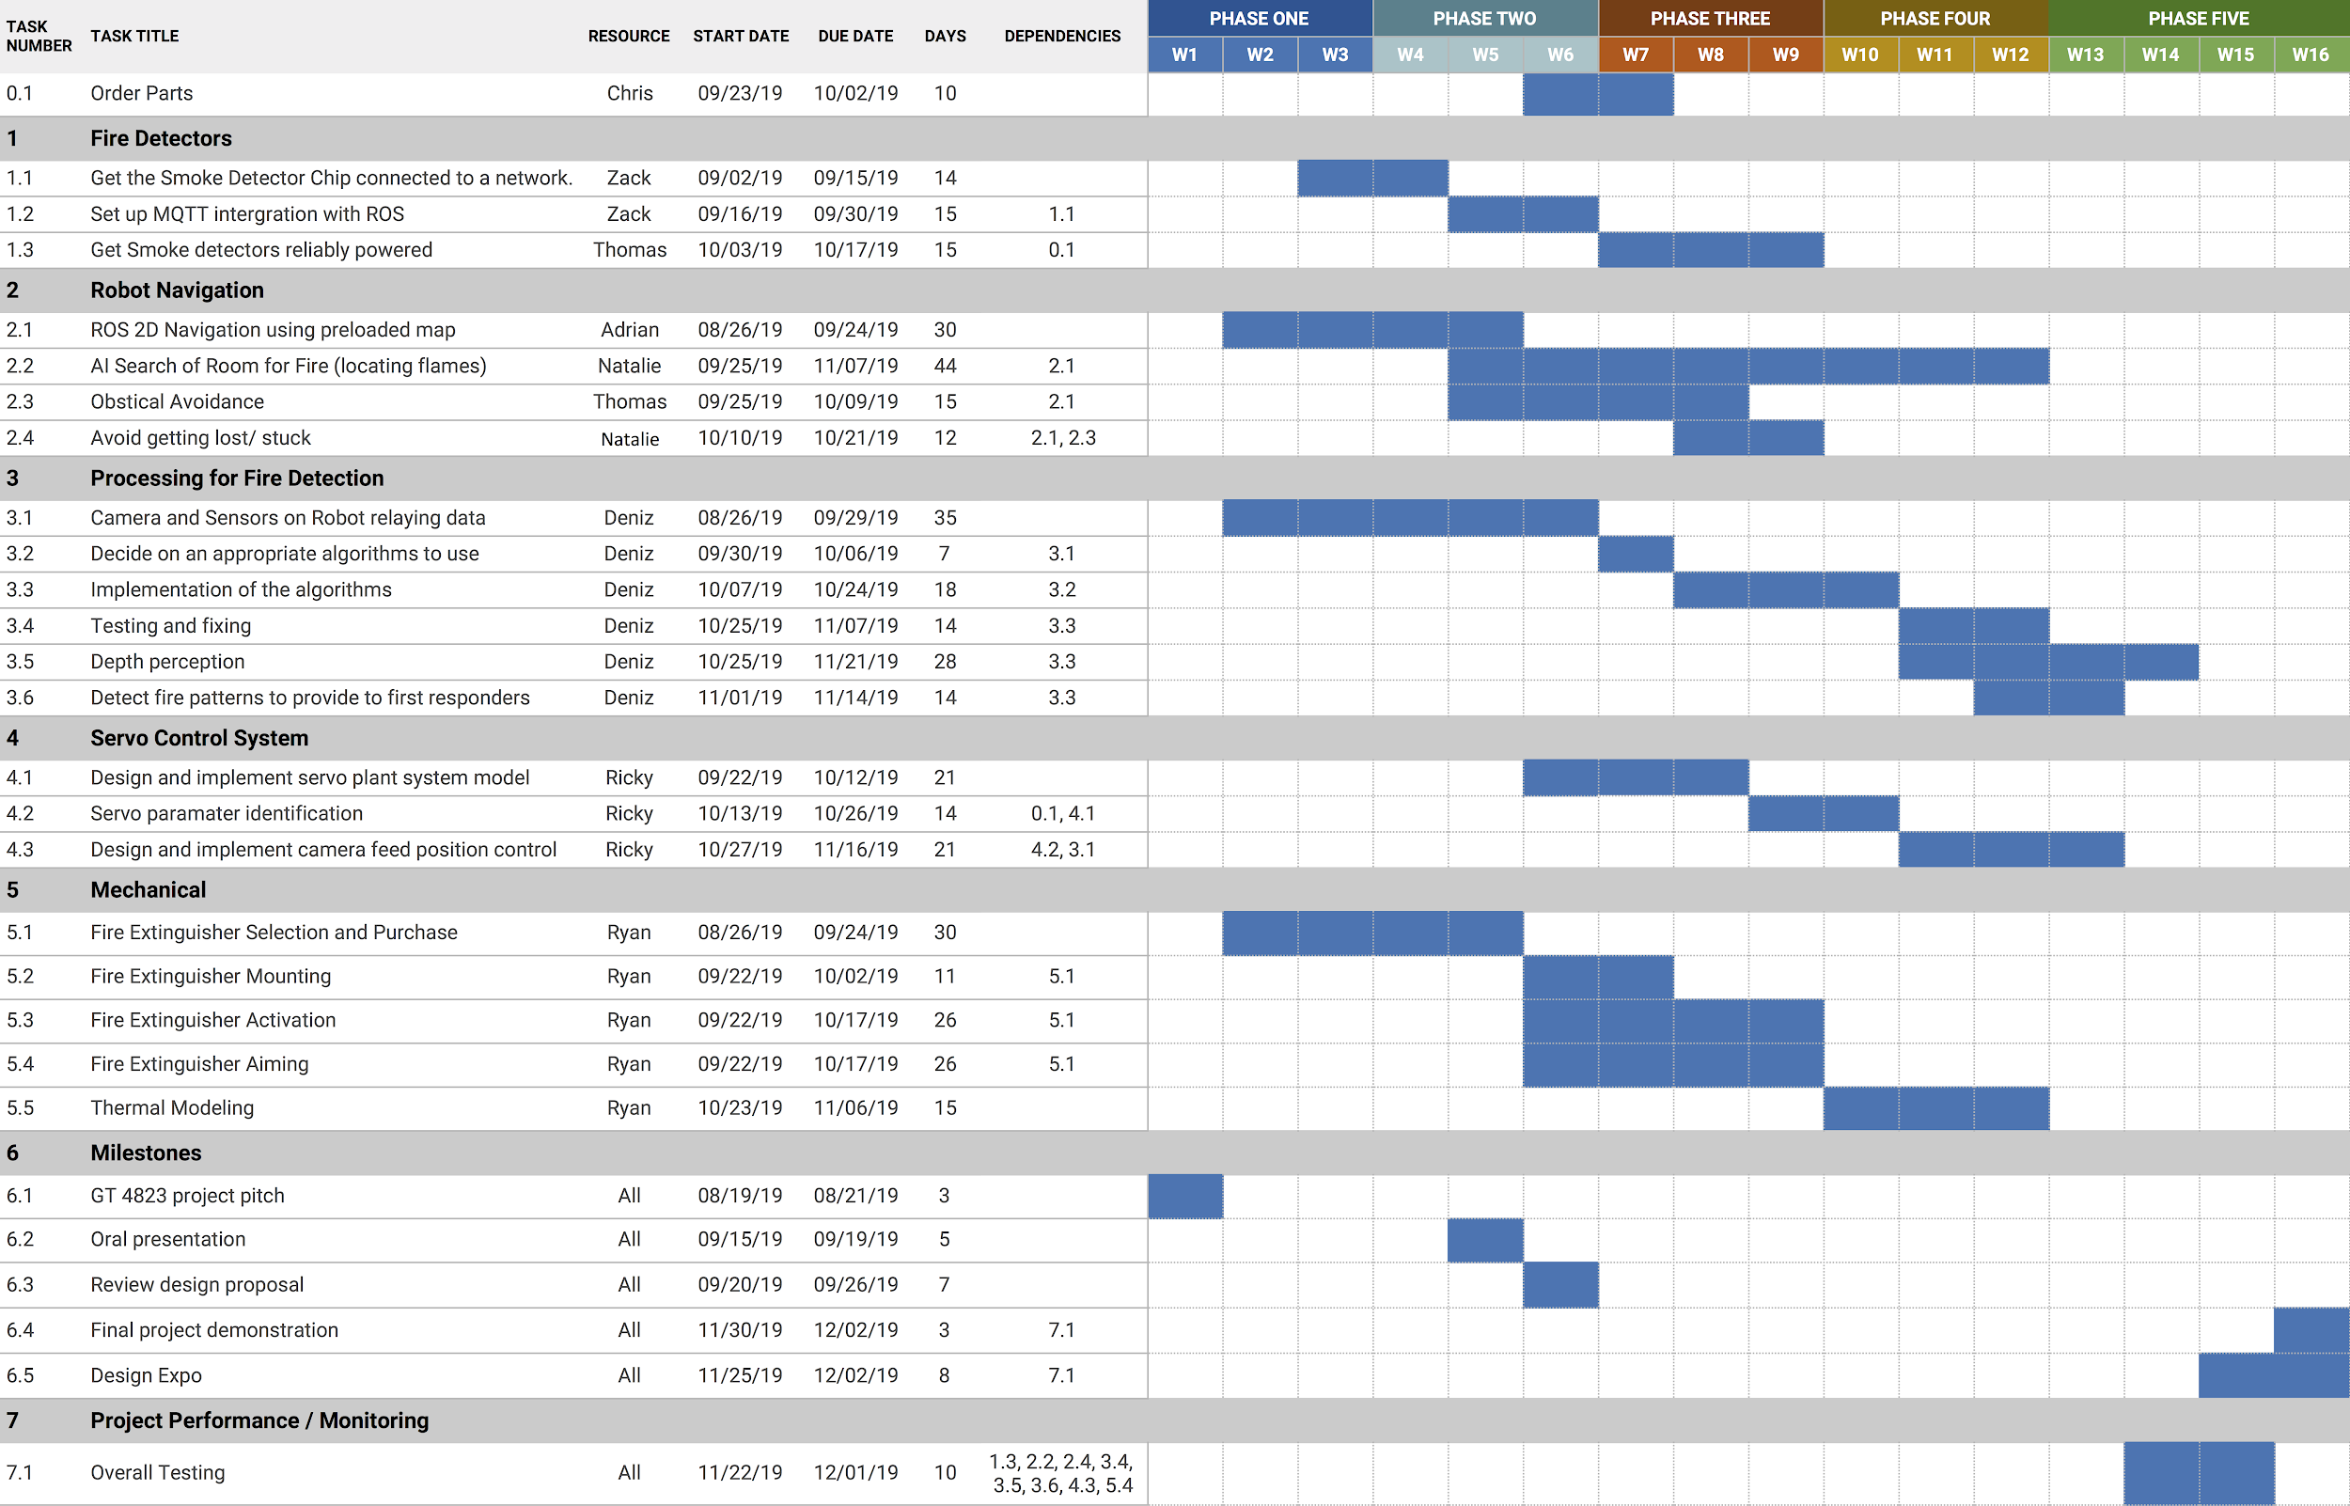
Schedule
Notes:
Ricky
Here is the Gantt chart we had created for the project schedule. It has been revised from the previous version found in the project proposal to accommodate some technical difficulties earlier this semester, and also the milestones dates that have been determined.
We have started to work on the project on the 26th of Aug, and are projecting to finish by the 1st of Dec. The project will be presented on the capstone design expo on the 2nd of Dec.
Following the chart, the parts are to be ordered later this week and are expected to be obtained by 2nd of Oct. The ongoing fire detection systems are on track and to be completed on Oct 17. The robot navigation is also following the initial projection with its first task of generating map completed, and is expected to finish on the 7th of Nov. The fire detection processing, such as the camera feed, is to be completed on Nov 21st. Due to some changes made on the servo option, the servo control system for the fire extinguisher aim will start beginning next week and expected to finish on Nov 16. Mechanical section of the project such as the thermal model, mount, packaging, and fire extinguisher release mechanism are to be completed on the 17th of Oct. With all of the section completed the final overall testing will begin on Nov 22nd and expected to end on Dec 1st. Final project demonstration will be done together with the capstone design expo, which is the 2nd of Dec.

Slide 11
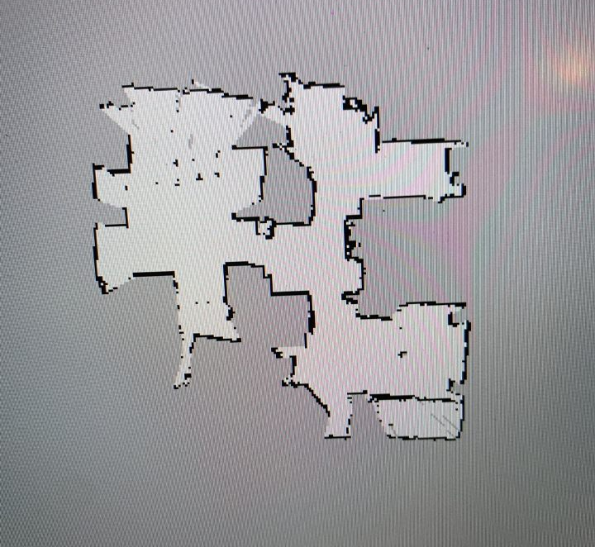
Status
Smoke detectors working, sending out Mqtt messages
ROS launch file to bring up robot control and sensors
Generated a rudimentary map of our testing area to use for robot navigation
Notes:
Adrian

Slide 12
Codes and Standards
OSHA 1910.157 - Portable fire extinguishers
Robot Operating System (ROS) standards
IEEE 801.22 WIFI
Notes:
Deniz

Slide 13
Tradeoffs
Using SLAM VS Using a static map
Color camera VS FLIR camera for fire identification and location
Low power smoke sensing VS Active, IR-based flame detection in smoke detectors
Notes:
Deniz

Slide 14
Demonstration
Closed presentation with live fire and extinguisher in a mock apartment layout
Recorded and played at Expo to demonstrate qualitative specifications
Prior unit testing to verify quantitative specifications
Notes:
Natalie

